Slide 1
Dynamic Analysis – Perform Analysis
AVCDL-Implementation-8.1.3
Charles Wilson
Staff Product Cybersecurity Architect
version 2
2025-11-06
Notes:
Script:
I'm Charles Wilson, staff product cybersecurity architect at Torc Robotics.
This presentation will cover the Dynamic Analysis Perform Analysis activity.

Slide 2
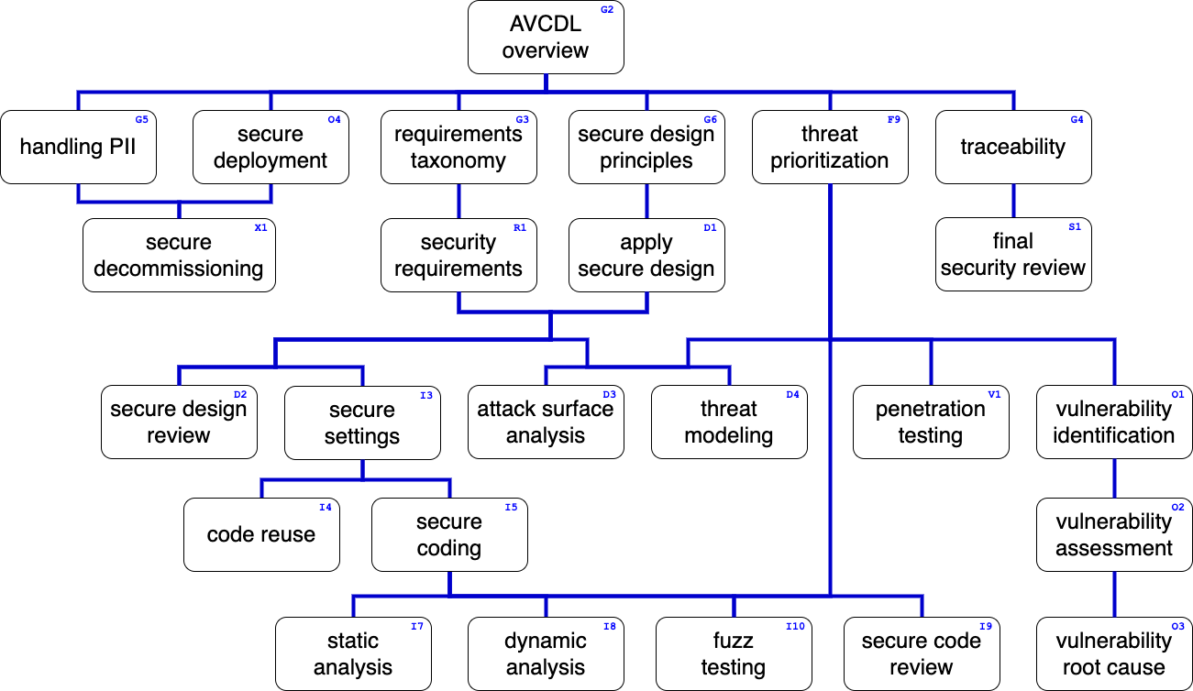
Training Path
Notes:
Script:
This diagram shows the overall AVCDL training path.
If you're taking this training, it's assumed that you've already completed the AVCDL Overview training,
and additionally, that you've completed the
Requirements Taxonomy
Security Requirements
Secure Design Principles
Apply Secure Design
Threat Prioritization
Secure Settings
Secure Coding
Dynamic Analysis Overview
Dynamic Analysis Establish Settings
and
Dynamic Analysis Instrument Element
trainings.
This training will cover the Dynamic Analysis Perform Analysis activity.

Slide 3
Introduction
Notes:
Script:
Before getting into the performing analysis activity, let's briefly review where it fits in the overall dynamic analysis process.

Slide 4
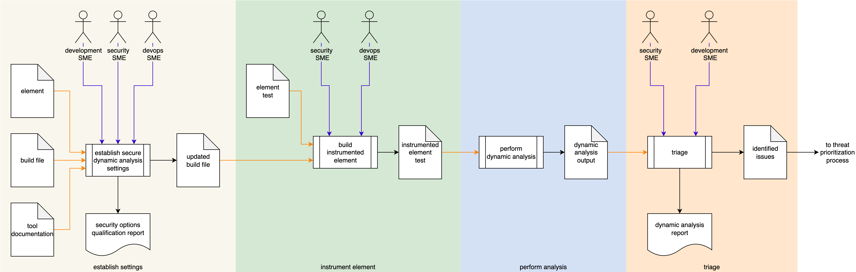

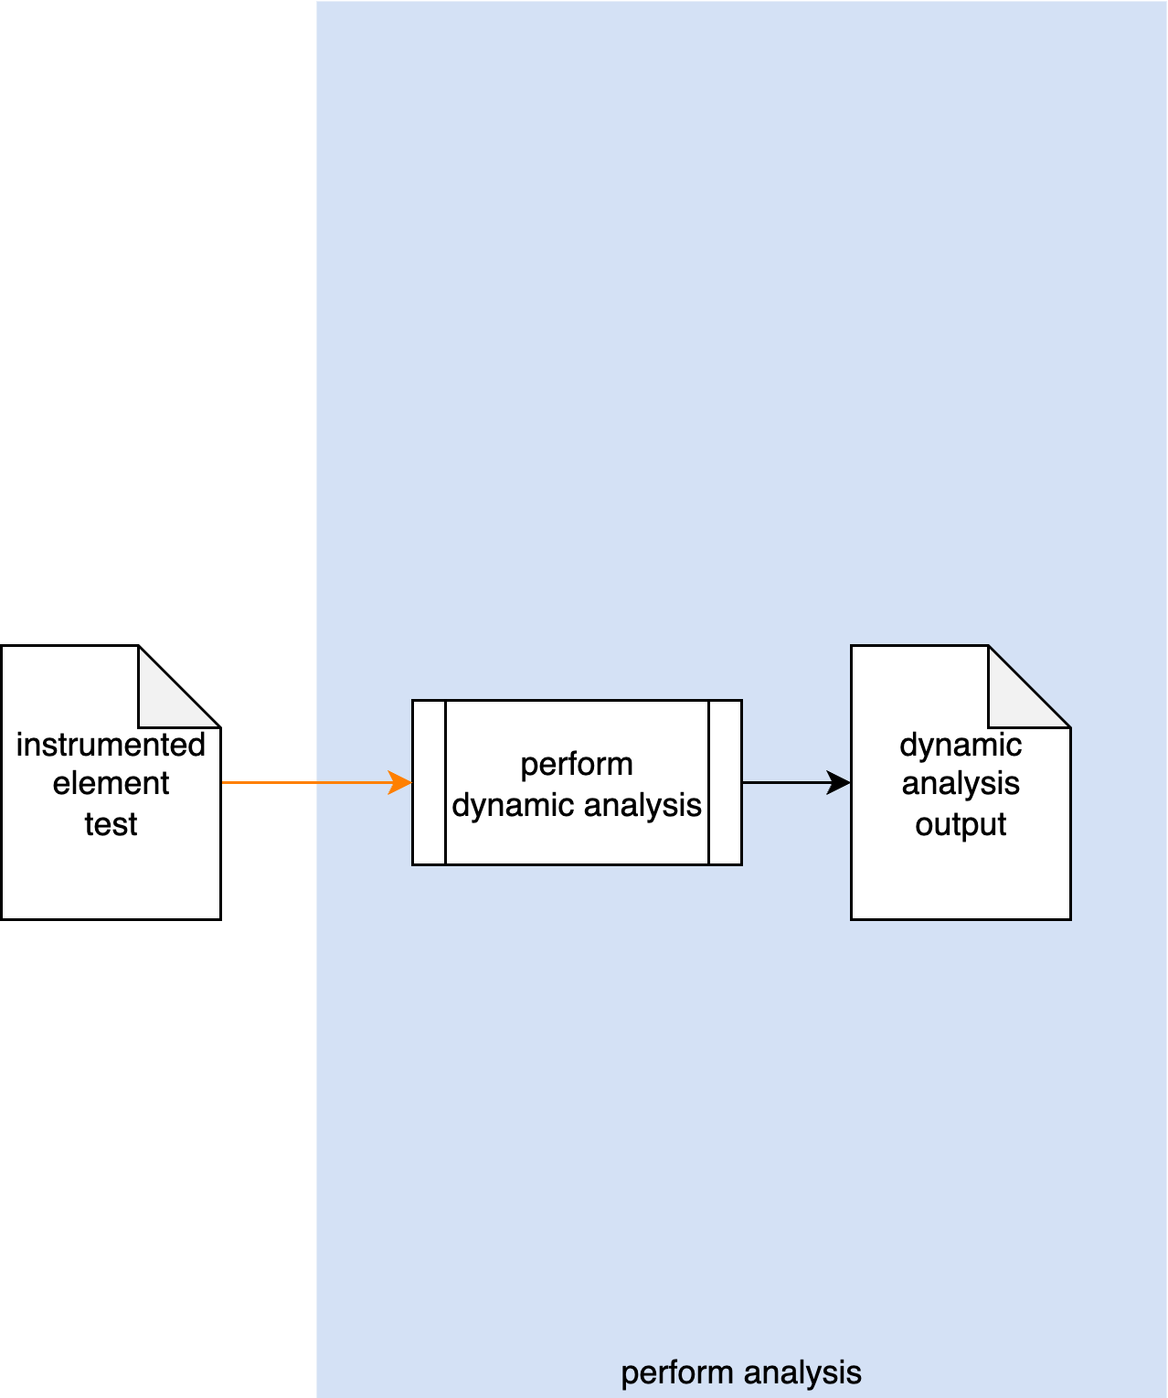
Dynamic Analysis Process
Notes:
Script:
Here's the dynamic analysis process which we previously covered in the Dynamic Analysis Overview.
[break]
Our focus for this training is going to be on the third activity, that of performing the analysis.

Slide 5
Dynamic Analysis Process
Notes:
Script:
Here's the dynamic analysis process which we previously covered in the Dynamic Analysis Overview.
[break]
Our focus for this training is going to be on the third activity, that of performing the analysis.

Slide 6
Perform Analysis Activity
Notes:
Script:
Within the perform analysis activity,
[pause]
the instrumented element test, based on a specific dynamic analysis tool
[pause]
performs its analysis activity,
[pause]
generating a dynamic analysis output file.
[pause]
Now, this activity is presumed to be performed within a CI/CD pipeline and as such requires no participation by people.
It may be the case that the test is run manually, however.
In the general case, it's assumed that it's not, that automation is being employed.

Slide 7
Runtime Considerations
Notes:
Script:
So given the title of this section, runtime considerations, one might be inspired to think,
“Didn't we just cover this in the element instrumentation activity training?”
And the answer for that is yes.
Although the considerations that were discussed in that training should have been addressed during the actual instrumentation activity,
there may still be things which will need to be addressed when the test goes live.
Let's revisit some of those.

Slide 8
Considerations
Termination on error
Issue occlusion
Cybersecurity side-effects
Notes:
Script:
The first and arguably most important consideration is that of termination on error.
It's not uncommon for someone to create a test and put it into the build system,
only to have it crash and burn.
This is, of course, the traditional, “it works on my machine” problem.
It’s exacerbated because dynamic analysis tests which are configured to terminate on error, will in fact, do just that.
It's critical that regardless of whether the test terminates on error, or simply return an error code,
that you handle the behavior in a way that allows the CI/CD pipeline to continue to its next task.
This includes cleaning up any residual state that may exist.
[pause]
Regardless of how many times one emphasizes this, it still shows up as an issue.
[pause]
The next is related to the first, and that is issue occlusion.
When an issue is detected, you have to ensure that it’s not masking more fundamental issues.
The mechanism for this was addressed in the training on element instrumentation.
[pause]
Finally, since the systems which are looking at cybersecurity from an external standpoint may be triggered by the data exposed by the element’s instrumentation,
we need to make sure that these external tests are turned off for the duration of the dynamic analysis or otherwise flagged so that they're not generating false positives related to the element under consideration.

Slide 9
Recap
Notes:
Script:
With that, we've covered the treatment of the analysis activity within the dynamic analysis process.
Let's look at some takeaways.

Slide 10
Summary
Pre-flight the pipeline
Account for error conditions
Notes:
Script:
There are two main points to keep in mind when performing dynamic analysis, and strangely enough, they don’t have to do with performing the analysis itself.
[pause]
The first is pre-flighting the pipeline before the actual test goes live.
[pause]
The second is accounting for error conditions after the test runs.
[pause]
It’s presumed that by the time you're putting the test into the build system that you’ve confirmed that the test runs with the code of interest.

Slide 11
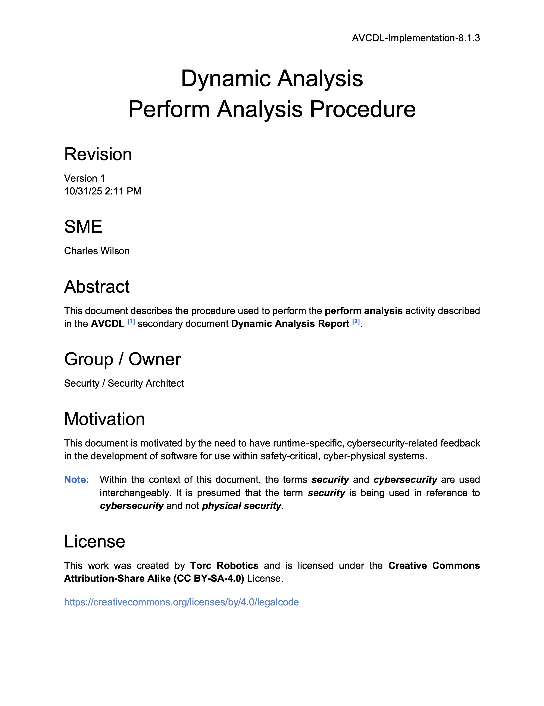
Further Reading
Notes:
Script:
For additional information and to get a more in-depth set of references, the Dynamic Analysis Perform Analysis Procedure tertiary document is available in the AVCDL GitHub repository.

Slide 12
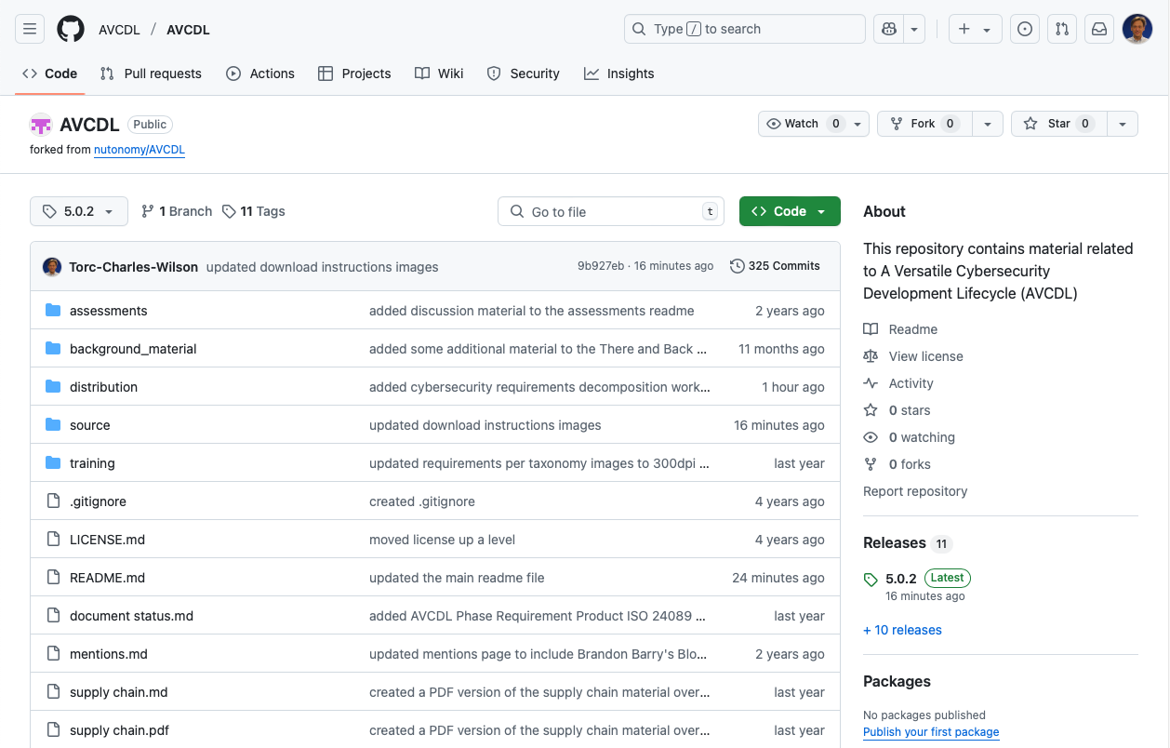
AVCDL on GitHub
https://github.com/AVCDL/AVCDL
Notes:
Script:
All AVCDL materials, both in source and distribution forms, are available on our GitHub site, as shown here.
Because of the size of the repository, it's recommended that you either clone the repository or download a ZIP archive of it, if you're not familiar with using git.
Instructions for downloading a ZIP archive are linked to on the repository’s front page.

Slide 13
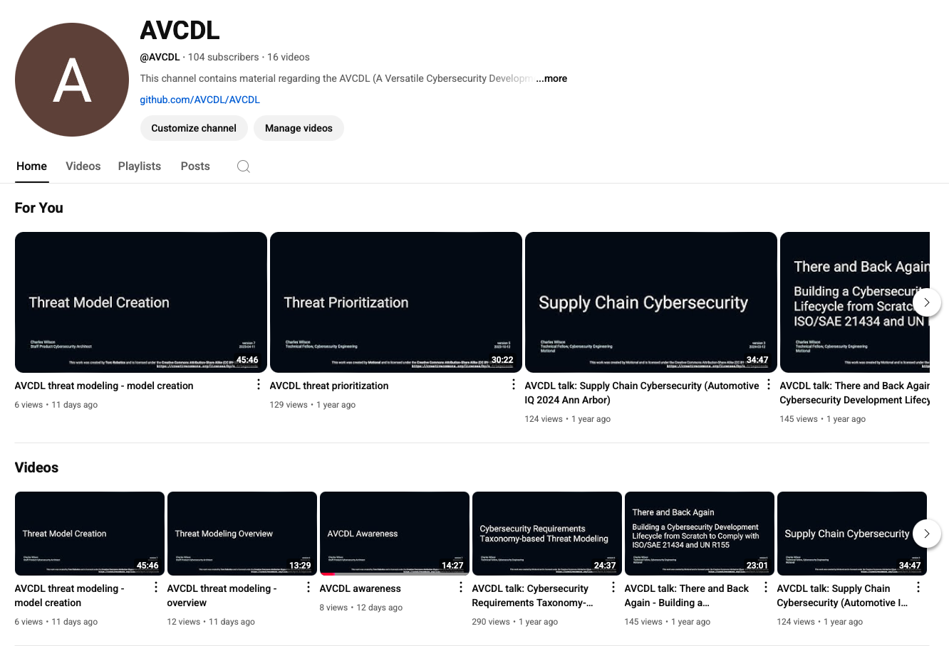
AVCDL on YouTube
https://youtube.com/@AVCDL
Notes:
Script:
Videos covering various aspects of the AVCDL are available on our YouTube channel, as shown here.
It's important to note that all AVCDL materials with the exception of the introductory blog posts are intended for product cybersecurity engineering practitioners.

Slide 14
Next Steps
Notes:
Script:
With this training complete, if you’ve completed the other trainings covering the Dynamic Analysis process activities, you can proceed to the other trainings at this level, these include:
Static Analysis
Fuzz Testing
and
Secure Code Review

Slide 15
References
AVCDL primary document
Dynamic Analysis Report (AVCDL secondary document)
Dynamic Analysis Instrument Element Procedure (AVCDL tertiary document)
Dynamic Analysis Perform Analysis Procedure (AVCDL tertiary document)
Notes:
Script:
Here are the references to the source material used in the creation of this presentation.
They'll also be included in the video description.
Additionally, this presentation’s source material will be provided on the AVCDL GitHub repository.

